Slide 1

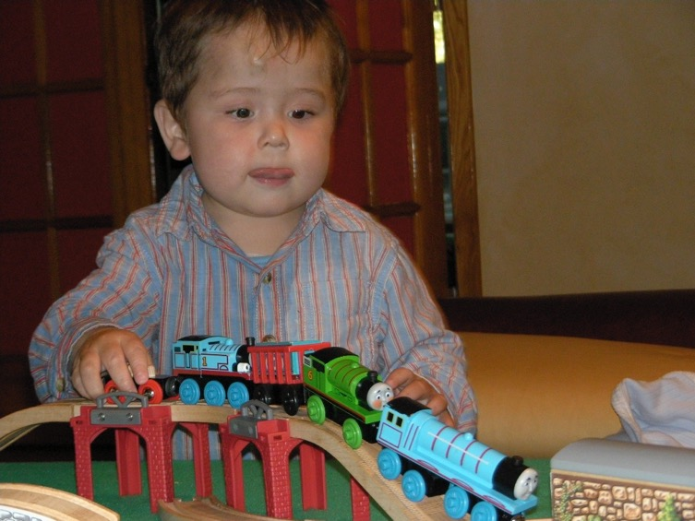
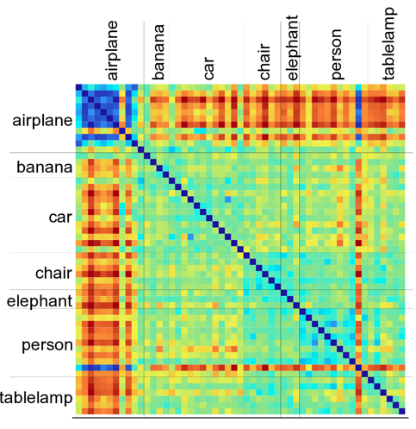
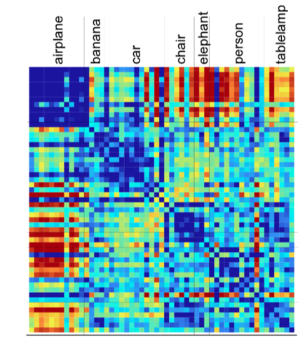
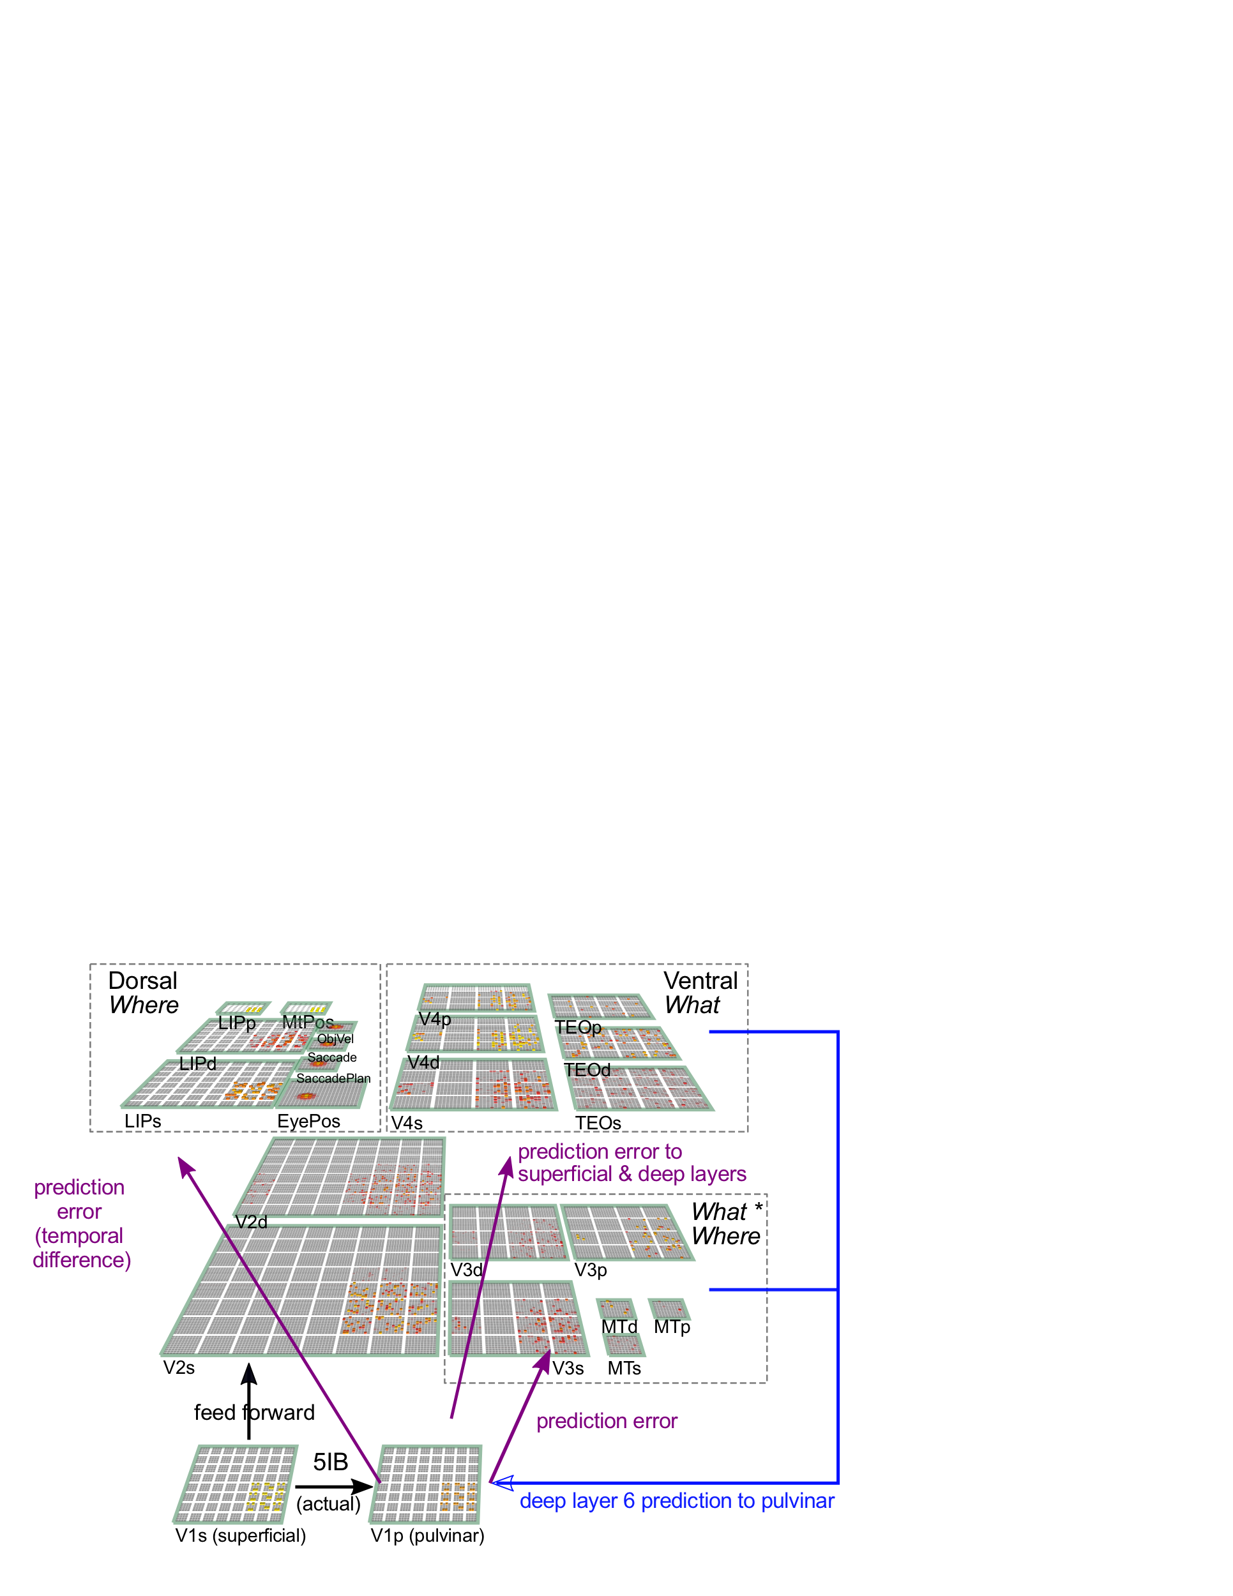
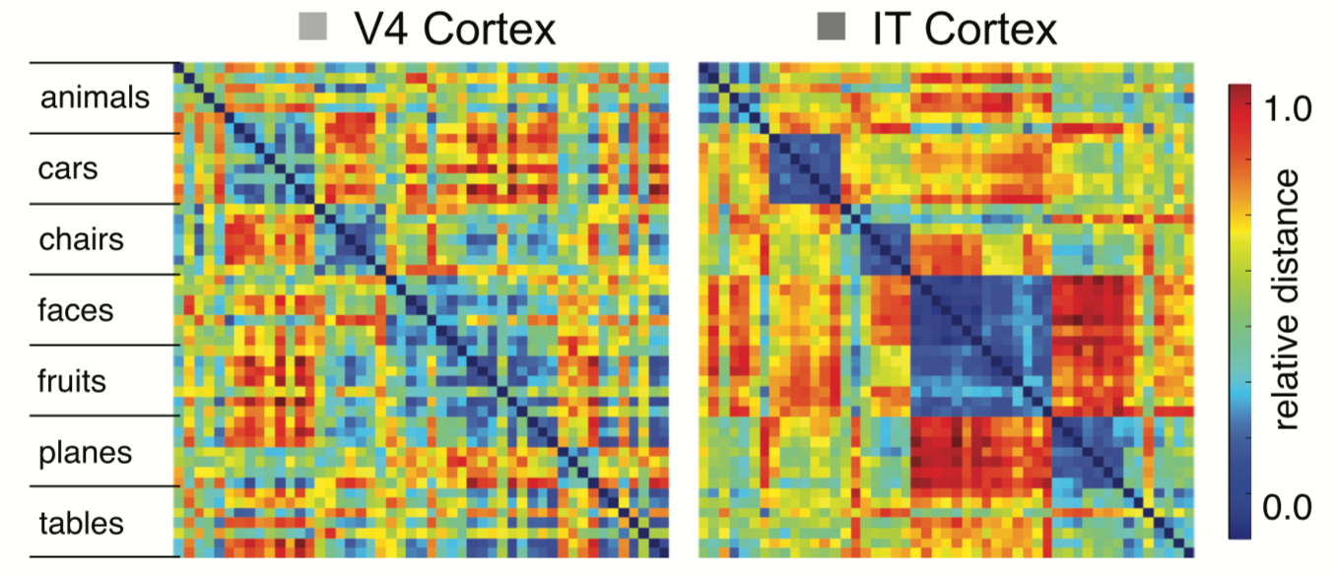
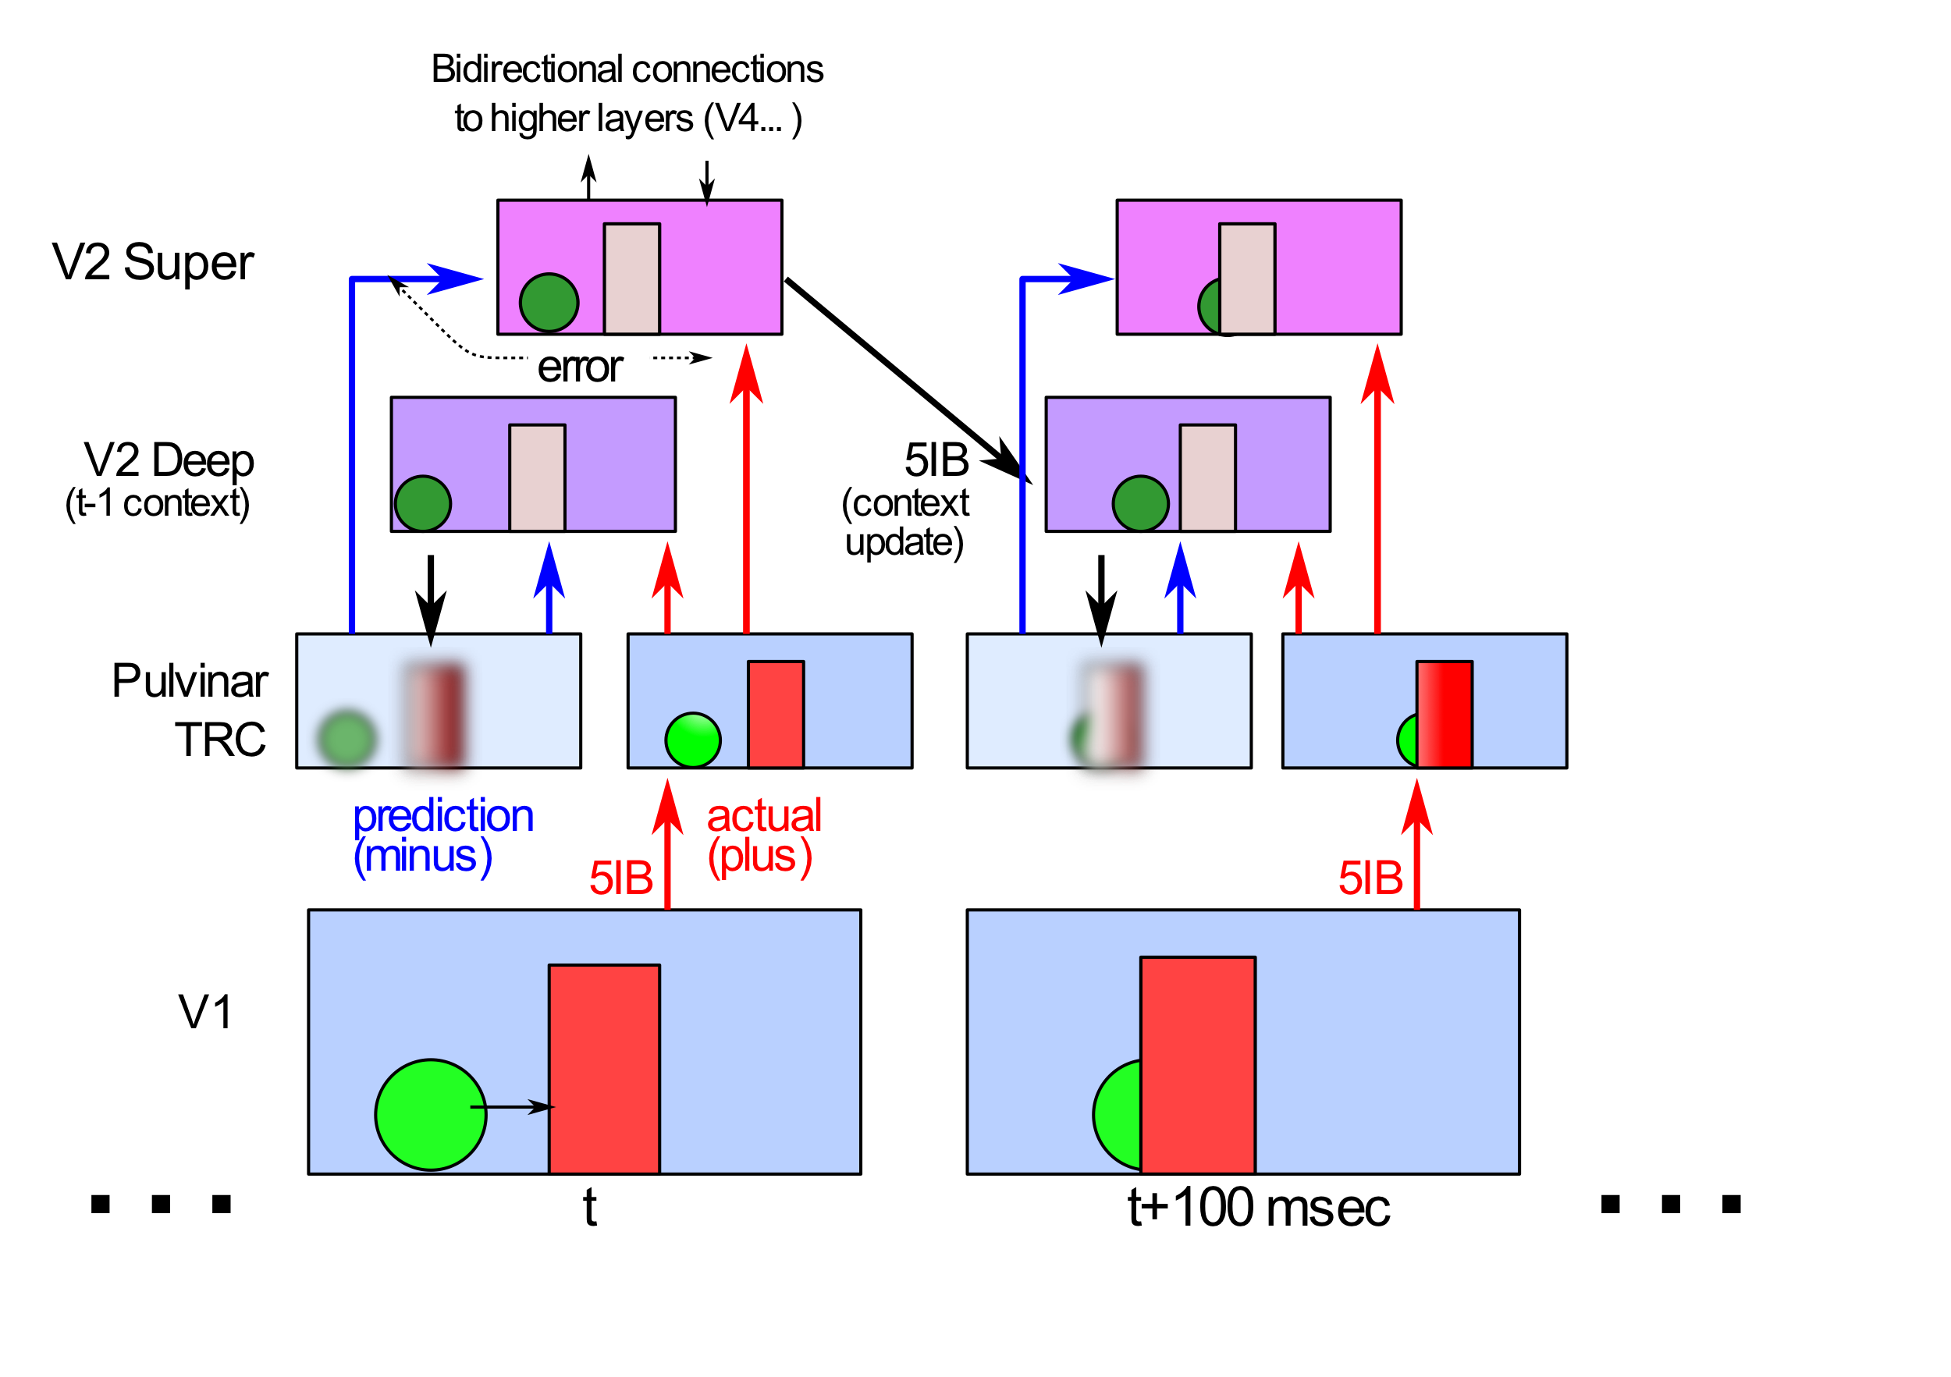
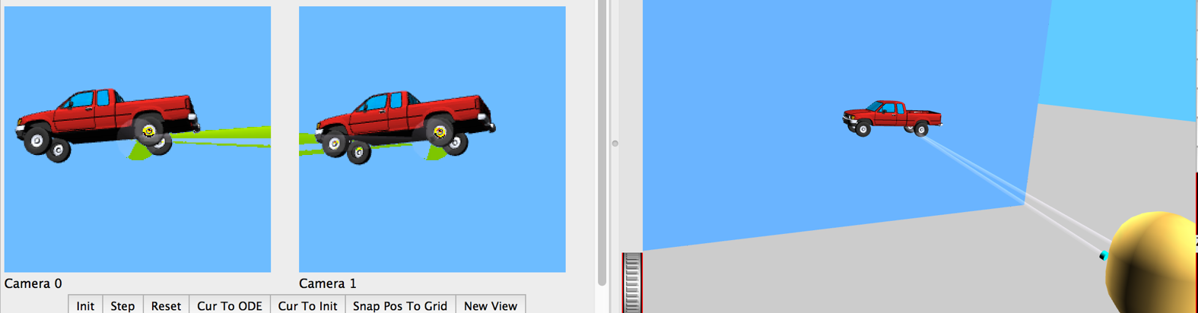
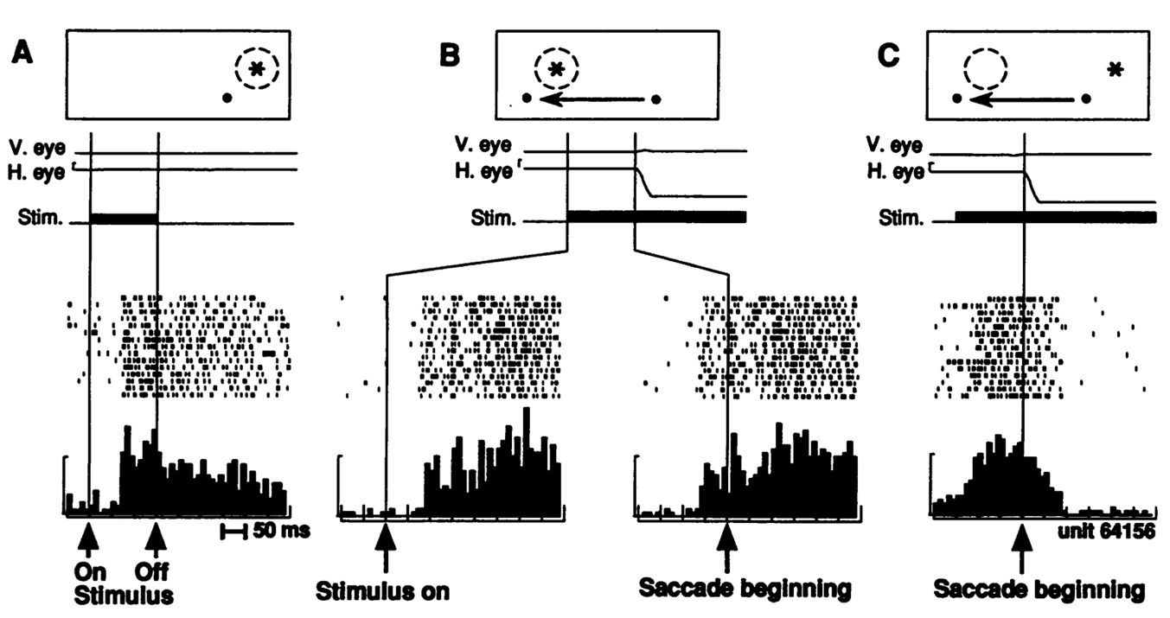
Invariant object recognition is hard
Deep Predictive Learning in Vision
John A. Rohrlich & Randall C. O’Reilly
University of Colorado Boulder
Where does our knowledge come from?
Central Hypothesis
Results
• How are invariant object representations formed?
• We propose error-driven learning from prediction/outcome in the cortico-thalamocortical loop
• Error-driven learning from difference between prediction and what happens next
• Prediction minus outcome cycle = 100ms = 10hz = alpha
• Cortical deep layers drive prediction on Pulvinar
• Layer 6CT neurons drive prediction
• 5IB (alpha burst) from deep layers drive outcome
• Error is temporal difference, broadcast from pulvinar
• Local temporal-diff learning throughout cortex
Model Data
IT forms more consistent, invariant categorical representations than V1 or V4 (blue squares on dialgonal)
• Different objects in same location share many features
• Same object in different locations share no features
• Hebbian: “fire together = wire together” – exact opposite!
The Predictive learning cycle
Macaque Data
Cadieu et al, 2014
(DiCarlo lab)
Deep CNNs rely on large datasets
• Deep CNNs solve invariant recognition problem but rely on huge datasets of hand-labeled images.
Differences with other predictive/generative models
• No explicit error-coding framework, where certain neurons explicitly subtract the top-down model-based signals from the bottom-up sensory-driven signals.
• These error signals are sometimes referred to as “prediction errors” but this sense of the word prediction does not typically include the critical “about the future” aspect.
• This “generative error” is fed forward via the superficial layers rather than via the thalamus.
If you can predict it you know it!
• Predictive models infer from prior sensory input to predict next sensory input.
Implemented Model
Summary
• A comprehensive, biologically consistent framework, explaining how prediction on a 100 msec cycle produces learning.
• The pulvinar nucleus acts as a projection screen for predictions generated by deep layers of cortex.
• Bottom-up, sparse, driving inputs from layer 5 intrinsic bursting neurons provide the target signal.
• The temporal difference between target and prediction reverberates throughout cortex, driving synaptic changes that approximate error backpropagation.
Predictive remapping
• LIP neurons anticipate effect of saccade, start firing at new location before fixation lands (even before saccade starts!)
References
Buffalo, E. A., Fries, P., Landman, R., Buschman, T. J., & Desimone, R. (2011). Laminar differences in gamma and alpha coherence in the ventral stream. Proceedings of the National Academy of Sciences of the United States of America, 108(27), 11262–11267.
Lee, T. S., Yang, C. F., Romero, R. D., & Mumford, D. (2002). Neural activity in early visual cortex reflects behavioral experience and higher-order perceptual saliency. Nature Neuroscience, 5(6), 589–597.
Lotter, W., Kreiman, G., and Cox, D. (2016). Deep predictive coding networks for video prediction and unsupervised learning. arXiv:1605.08104
Mumford, D. (1991). On the computational architecture of the neocortex. Biological Cybernetics, 65(2), 135–145.
O'Reilly, R.C., Wyatte, D., and Rohrlich, J. (2017). Deep Predictive Learning: A Comprehensive Model of Three Visual Streams. arXiv: 1709.04654
Sherman, S., & Guillery, R. (2006). Exploring the Thalamus and Its Role in Cortical Function. Cambridge, MA: MIT Press.
Shipp, S. (2003). The functional logic of cortico-pulvinar connections. Philosophical Transactions of the Royal Society of London B, 358(1438), 1605–1624.
This work supported by the following grants: Bidirectional Vision, ONR N00014-14-1-0670 / N00014-16-1-2128 and Deep Predictive Learning in Vision, ONR N00014-18-1-2116

